Slide 1

C# - Final Project
Elad Maayan 031722150
Netanel Azuviv 313152209

Slide 2



Agenda
App structural description
Framework and NuGet Technologies
Client frames
Server API functions
DB tables
Data flow

Slide 3

App structural description
Supports two types of clients:
- Teacher (create exam)
- Student (take exam)
Server side:
Support 4 main server-client functions (create, delete, post, update)
Using MongoDB

Slide 4
NuGets
We added MongoDB NuGet to our Project:
MongoDB.Driver
MongoDB.Driver.Core
MongoDB.Libmongocrypt

Slide 5
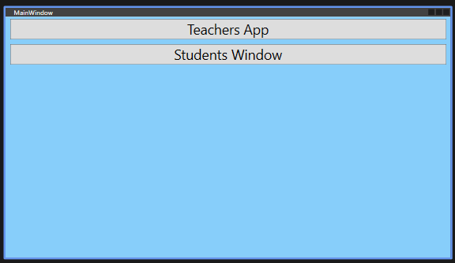
Client frames
Main window:

Slide 6
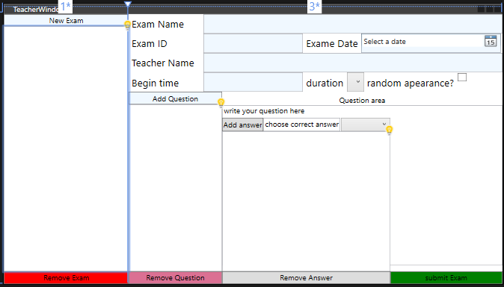
Client frames
Teacher window:

Slide 7
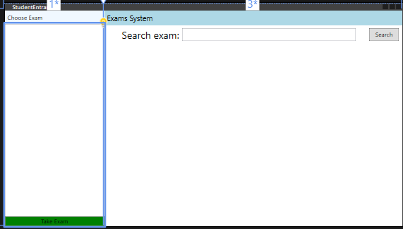
Client frames
Student entrance:

Slide 8
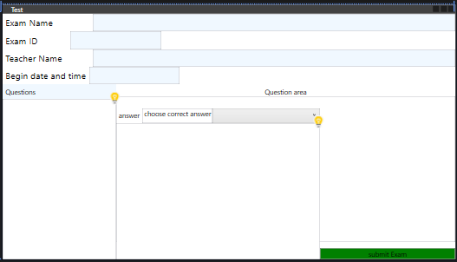
Client frames
Teacher window:

Slide 9
Server API functions
public async Task<ActionResult<Exam>> PostExam(Exam exam) – create an exam on the DB from Teacher window
public async Task<ActionResult<Exam>> PostExam(int studentID, Exam exam)– create a submitted exam from student window.
public void PutExam(string id, Exam exam) – update exam, from teacher window only
public List<Exam> GetExams() – get all exams
public Exam GetExam(string id) – get a specific exam
public async Task<IActionResult> DeleteExam(string id) – Delete an exam, from teacher app only

Slide 10
DB tables
MongoDB is Non-SQL, so we used the following collections:
Exams – a collection for all exams, managed by teacher
Answers – a collection for all submitted exams, including selected answer by the student for each question.

Slide 11
Data flow
Teacher
Teacher window
Exam
DB
DB
Student entrance
Exam
Answers
DB

Slide 12


Thank You
Elad and Nati

